Slide 1
Using Distributed Reinforcement Learning for Resource Orchestration in a Network Slicing Scenario
Federico Mason , Gianfranco Nencioni ,and Andrea Zanella, (IEEE/ACM Transaction on Networking 2023)

Slide 2
Background
Distributed Machine Learning:
A broader category of decentralized learning where data can be stored and processed across multiple nodes, including cloud servers, data centers, or distributed networks.
Focus on scaling large datasets and computational processes across multiple machines to enhance processing power and reduce training time

Slide 3
Background
Federated Learning:
A decentralized machine learning technique where the training data remains on edge devices.
Instead of moving data, FL brings the model to the data. The model is trained locally, and only the updated model parameters (not the raw data) are sent back to a central server where they are aggregated to improve the global model.

Slide 4
Distributed Machine Learning vs Federated Learning:
Feature | Distributed Learning | Federated Learning
Data Location | Centralized or distributed with shared access | Decentralized, residing on devices
Privacy Focus | Lower priority | High priority
Data Sharing | Data is shared directly | Only model updates are shared
Typical Use Cases | Large-scale cloud-based models | On-device AI, privacy-preserving applications
Advantages | Improved training speed and scalability | Enhanced data privacy, improved bandwidth efficiency, greater scalability
Challenges | Potential privacy concerns, reliance on centralized data | Communication overhead, data heterogeneity, security/privacy risks

Slide 5
Background
3 main service classes of 5G and beyond:
eMBB: enhanced Mobile Broad Band.
URLLC: Ultra Reliable Low Latency Communication.
mMTC: massive Machine Type Communication

Slide 6
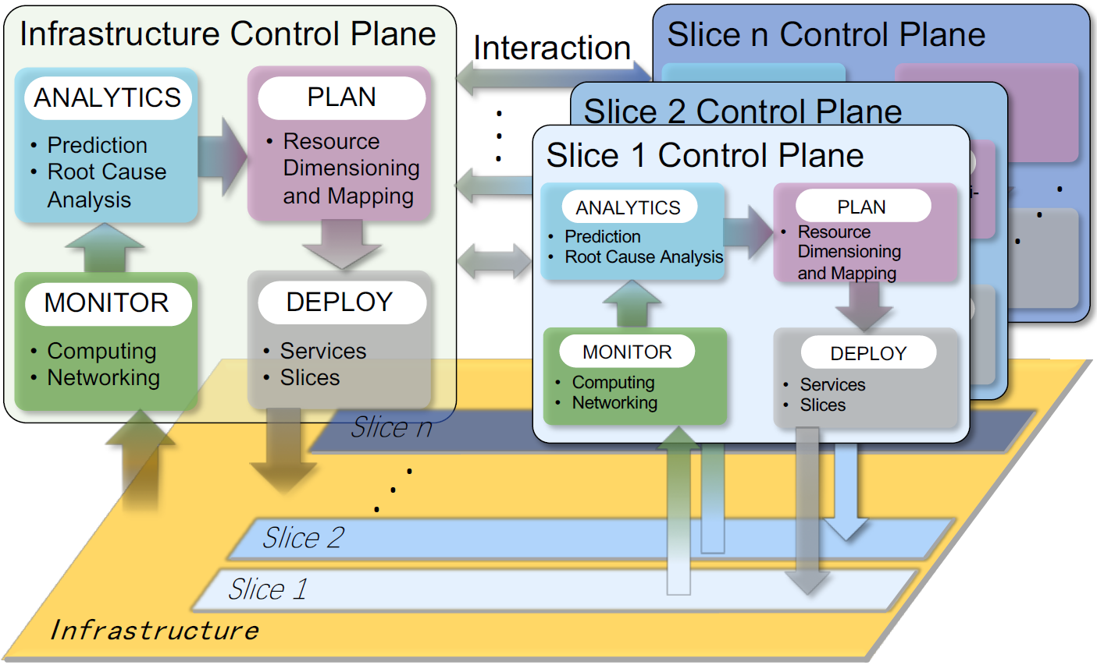
Background
Network Slicing for 5G:
Virtualization technologies can be employed to divide the network resources for different service classes.

Slide 7
Motivation: challenge of dynamic network slice allocation problem
Two slice classes (i.e., eMBB and URLLC) are to be initiated, with dynamic requirements in term of throughput, computational power, memory capacity, and delay.
Each slice is composed by multiple information flows contend for networking and computing resources.

Slide 8
Motivation:
existing work has not considered the heterogeneous network typologies at the network edge that may be much different from the cloud.
It is highly desirable to have a model that trades off delays and operating costs over the edge and the cloud

Slide 9
Objective
The authors aim to design a distributed reinforcement learning system.
In which multiple agents collaborate to allocate network resources among the different slices running over the same infrastructure.

Slide 10
Contribution
The development of a novel resource allocation strategy, based on DRL, that makes it possible to address the requirements of multiple slices in virtually any network topology.
Show how transfer learning can improve the performance of the system, by specializing the strategy learned by the agents in a scalable manner.

Slide 11
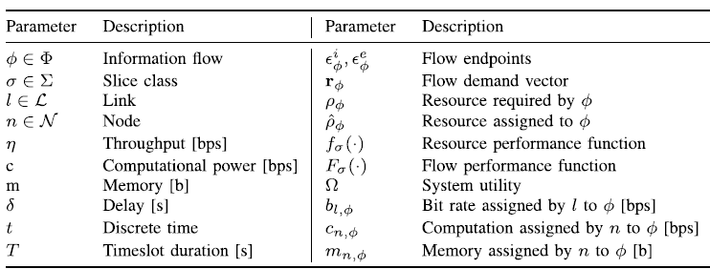
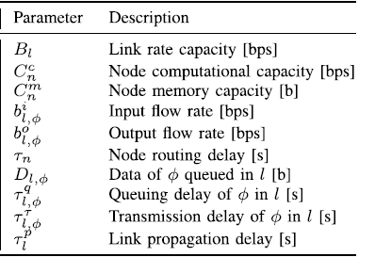

Slide 12

System Model: Slice Model
Network slice: An aggregation of information flows with similar behaviors and requirements. Each information flow is characterized by:
Flow endpoints:
Resource demand vector:
Performance function:

Slide 13

System Model: Slice Model
Network slice Class Considered:
Set of eMBB(e):
Set of URLLC(u):
Resource allocation vector:

Slide 14


System Model: Slice Model
Performance function depends on both r and ˆr, and returns a value in [0, 1]:
For eMBB(e):
For URLLC(u):

Slide 15
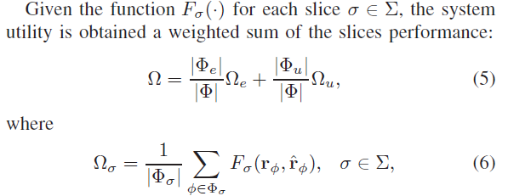
System Model: Slice Model
Optimization Goal: System Utility Function

Slide 16
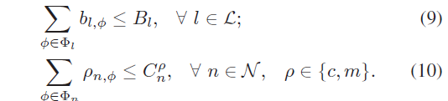
System Model: Network Model
Set of Nodes N: access and core nodes.
Set of Links L: fronthaul and backhaul.
Bandwidth and Computation Constraints

Slide 17



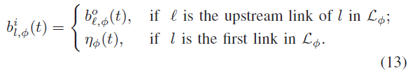
System Model: Network Model
Delay Constraints:
Resource Allocation Requests:

Slide 18
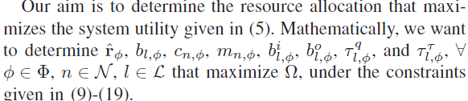
Problem Formulation

Slide 19
Learning Strategy
Distributed Architecture:
multiple learning units: local controllers.
RL algorithm adopted: Advantage Actor Critic(A2C).
Actor: determines the action according to the policy .
Critic: approximates the value function .
Critic Loss Function:
Advantage Function:
Actor Loss Function:

Slide 20
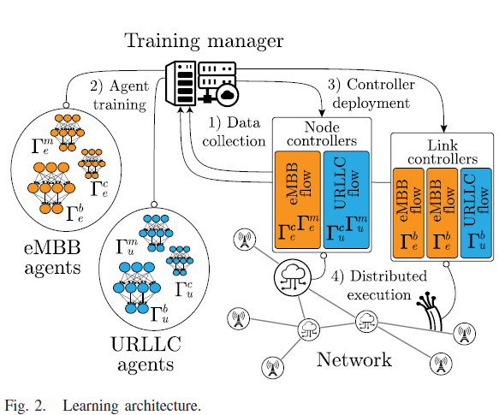
Learning Strategy

Slide 21
Learning Strategy
Observations:
Link controller: information flow status and network element it is associated with.
Node controller: states of the computation and memory resources assigned to φ by node n.
Action Space:
Link controller: the bitrate requested by φ at link l during timeslot t.
Node controller: the amount of computational (or memory) capacity demanded by φ to node n during timeslot t.

Slide 22
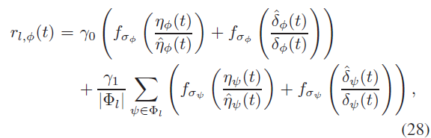
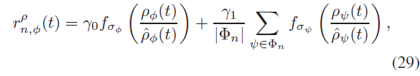
Learning Strategy
Reward Function :
To maximize the overall utility, each local controller should
demand enough resources to maximize the performance of
the flow φ it is in charge of, without subtracting too many
resources to the other flows.

Slide 23
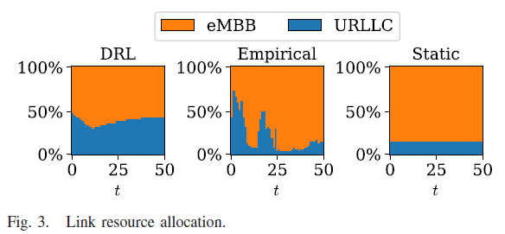
Simulation setup
Baseline Benchmark:
Empirical Strategy:
Static Strategy: Genetic Algorithm (GA)

Slide 24
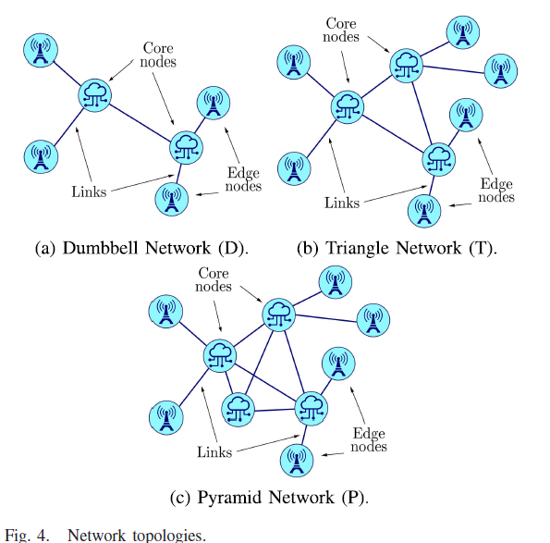
Simulation setup

Slide 25
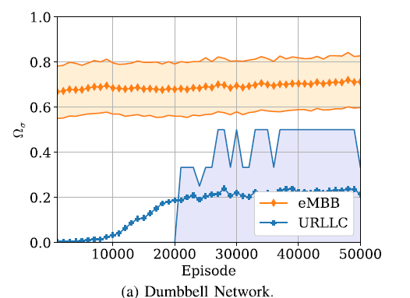
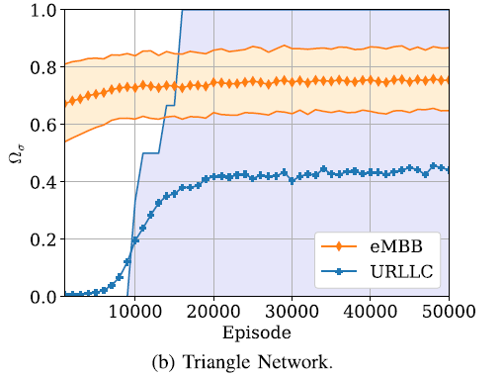
Evaluation result
Fig. 5. Training phase

Slide 26
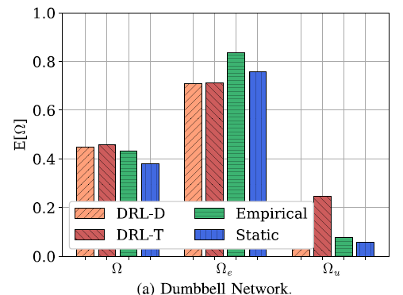
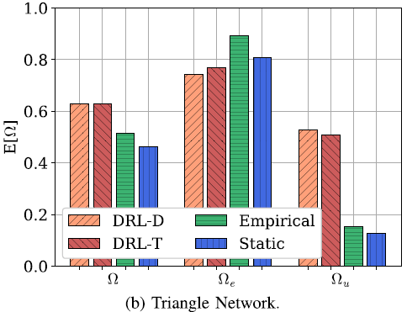
Evaluation result
Fig. 6. Expected Utility

Slide 27
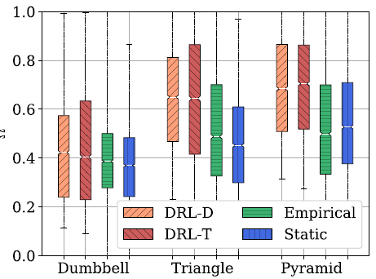
Evaluation result
Fig. 7. Utility Distribution

Slide 28
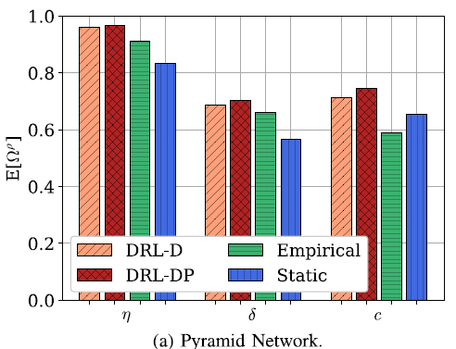
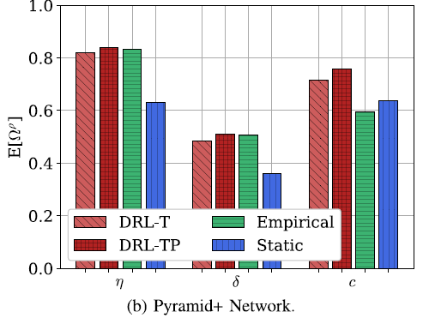
Evaluation result
Fig. 8. Expected Resource Utility

Slide 29
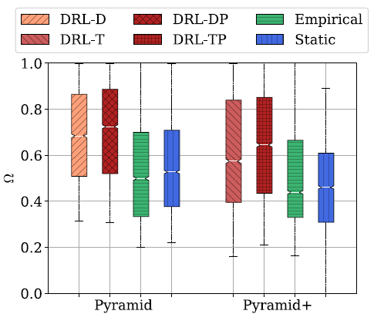
Evaluation result
Fig. 9. Utility Distribution

